Slide 1

HCI PROJECT
Hospital Management System
GROUP MEMBER:
AHMED ALI GHORI (60117)
SHIEKH ABDUL SAMAD (61324)
INSTRUCTOR: SIR.RIZWAN MUNIR

Slide 2
Introduction
MongoDB: NoSQL database for scalable and flexible data storage.
Express.js: Backend framework for creating robust APIs.
React.js: Frontend library for building interactive user interfaces.
Node.js: Runtime environment for server-side JavaScript execution.
Project Goal:
Develop a full-stack hospital management system to manage doctors, patients, appointments, and system configurations.
Provide a responsive and modern UI/UX experience.

Slide 3
Objectives
Develop Core Functionalities:
User management for roles: Admin, Doctor, Patient.
Real-time appointment scheduling and updates.
Doctor availability tracking.
Implement Role-based Access:
Admin: Full control over users and appointments.
Doctor: Manage their schedule and view patient details.
Patient: Book and manage their appointments.

Slide 4
Ensure Secure Data Handling:
Encrypt sensitive information (e.g., passwords).
Authenticate users securely.
Integrate Seamless Front-end & Back-end Communication:
Utilize RESTful APIs to fetch and store data dynamically.

Slide 5
Methodology
Front-end Development:
React.js for reusable components, routing, and state management with Context API or Redux.
Material-UI or Bootstrap for styling.
Back-end Development:
Express.js for routing and API endpoints.
Node.js for server logic and middleware integration.

Slide 6
Database Management:
MongoDB for storing structured and semi-structured data.
Mongoose for schema validation and queries.
Authentication:
Use JSON Web Tokens (JWT) for session management.
Implement middleware to enforce role-based access control.

Slide 7
Implementation (Part 1)
Setup and Configuration:
Initialize the project with create-react-app and npm init for backend.
Install dependencies: express, mongoose, bcrypt, jsonwebtoken, etc.
Database Connection:
Establish MongoDB connection using Mongoose.
Create schemas for:
Users: Role-based fields (admin, doctor, patient).
Appointments: Doctor, patient, date, status.

Slide 8
Authentication:
Implement user registration and login APIs.
Hash passwords with bcrypt.
Issue JWT tokens for authentication

Slide 9
Implementation (Part 2)
API Development:
Endpoints for CRUD operations:
POST /register: Create a new user.
POST /login: Authenticate users.
GET /appointments: Fetch appointments for specific roles.
PUT /appointments/:id: Update appointment status.
Front-end Integration:
Build dynamic React components for dashboards:
Admin dashboard for user and appointment management.
Doctor dashboard for viewing their schedule.
Patient portal for booking and managing appointments.
Appointment Management:
Allow patients to book based on doctor availability.
Notify doctors of new appointments via real-time updates (optional with WebSocket).
Enable cancellation or rescheduling.

Slide 10
Results
System Deliverables:
A fully operational hospital management system with key functionalities:
Multi-role support with tailored dashboards.
Real-time feedback for booking and updating appointments.
Role-specific access ensuring data security.
Improved efficiency in managing appointments and user data.
Technical Achievements:
Successful integration of front-end and back-end.
Performance optimization for faster API responses.
Responsive design for mobile and desktop compatibility.
Secure implementation of user authentication and data encryption.
successful project.

Slide 11
Conclusion
Value of the Project:
Showcases the MERN stack's versatility for real-world use cases.
Highlights the importance of role-based systems in application design.
Future Enhancements:
Add analytics for admin (e.g., appointment trends).
Implement email/SMS notifications for appointment updates.
Introduce a payment gateway for premium services.
Call to Action:
Explore the MERN stack through similar projects.
Customize this system for other domains (e.g., education, e-commerce).

Slide 12
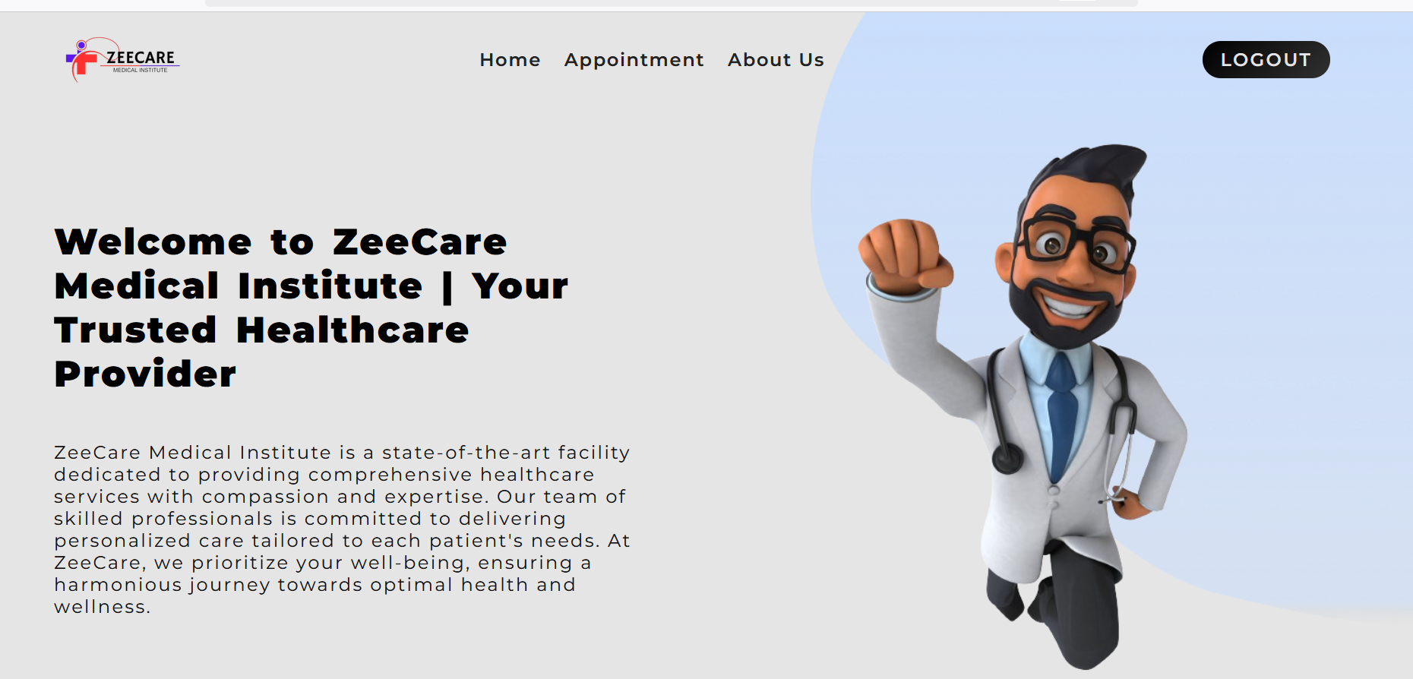

Slide 13
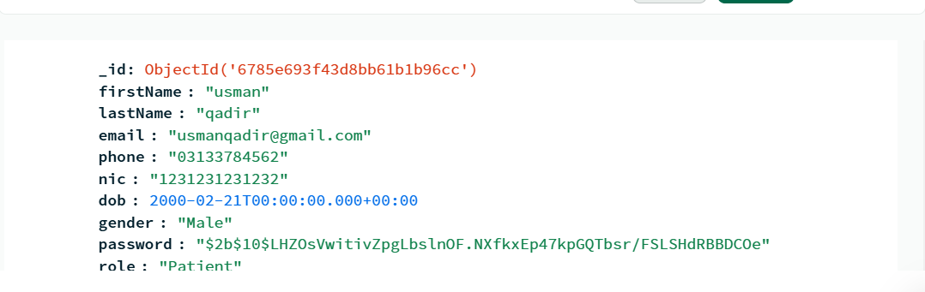

Slide 14
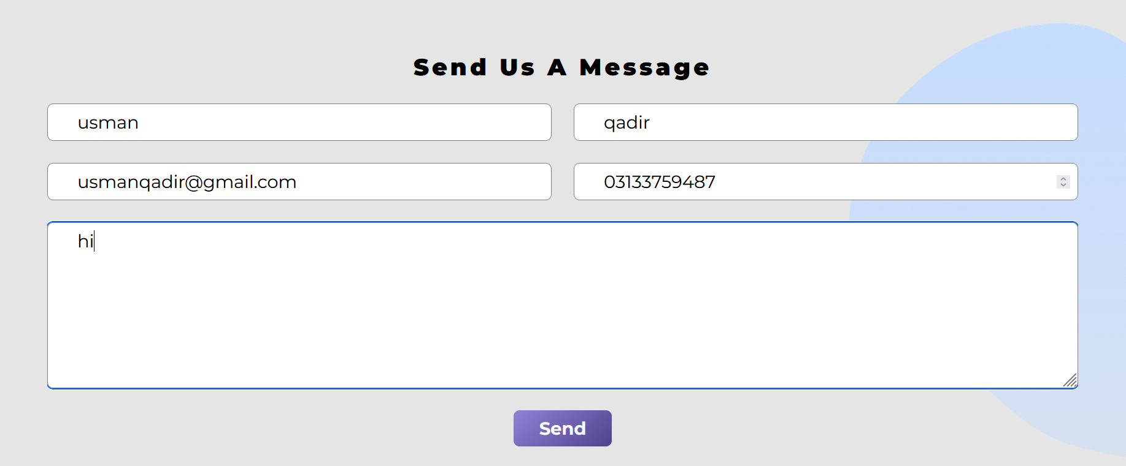

Slide 15
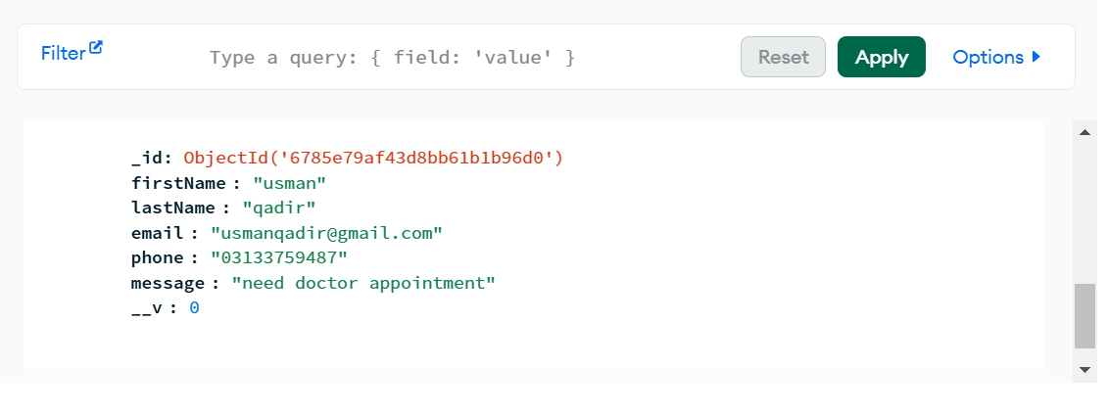

Slide 16
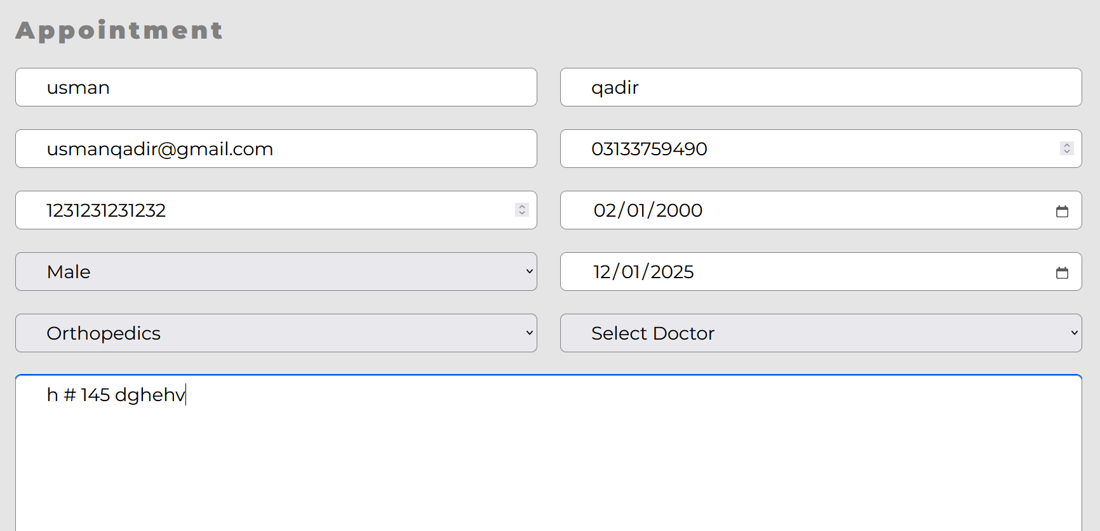

Slide 17


Slide 18
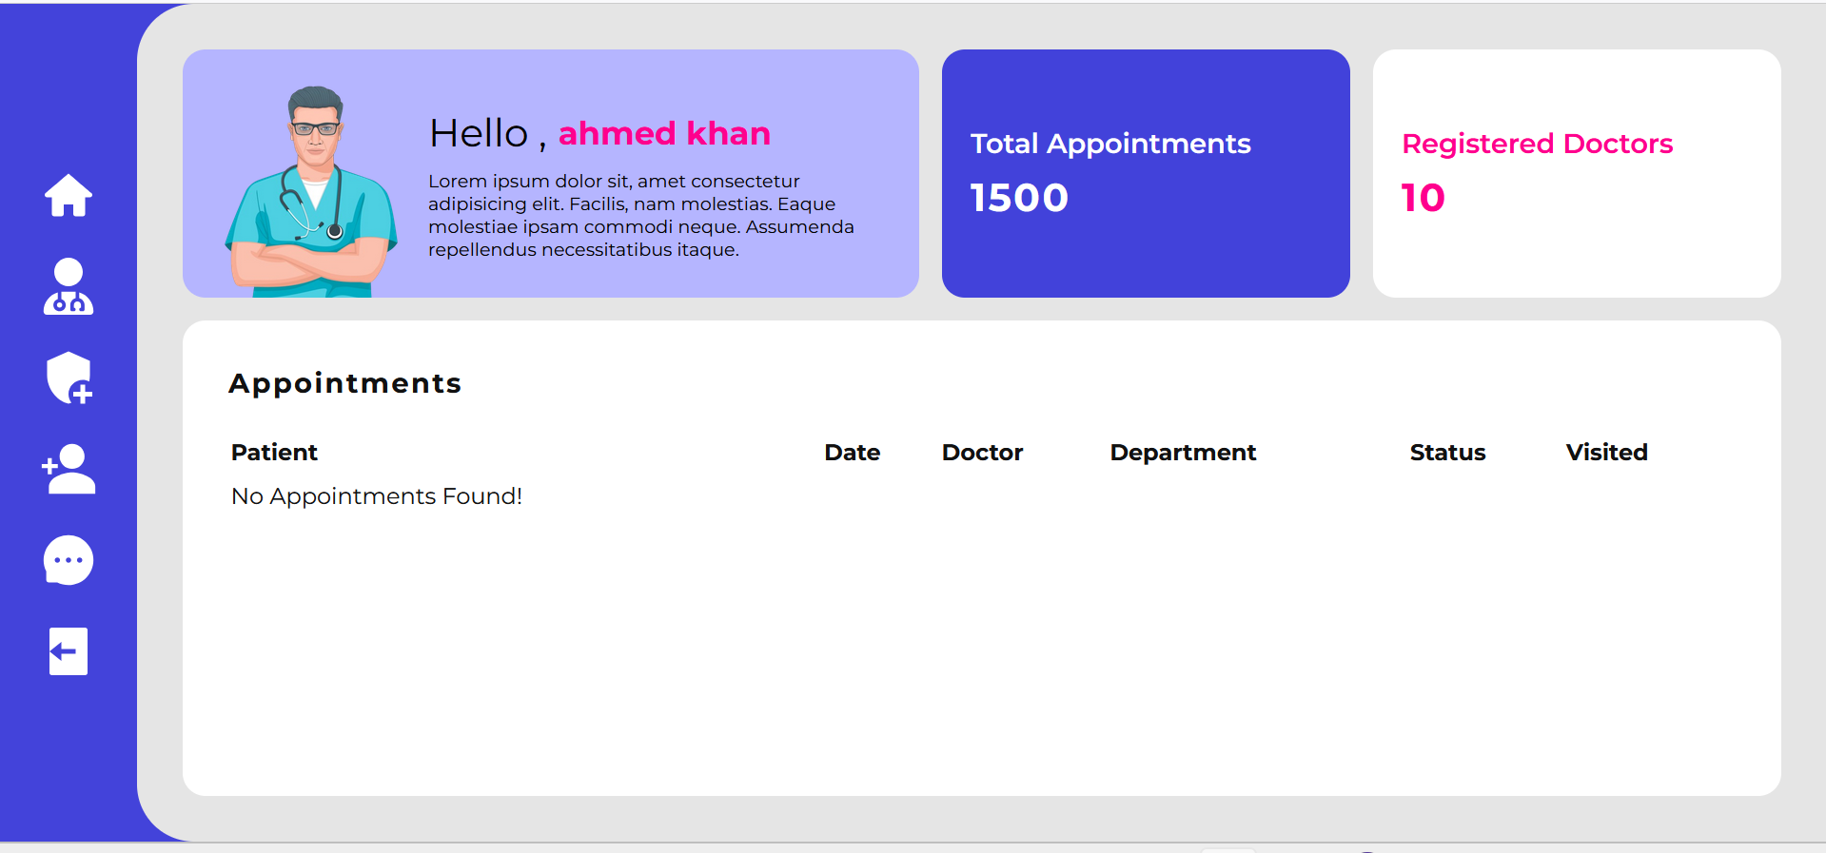

Slide 19
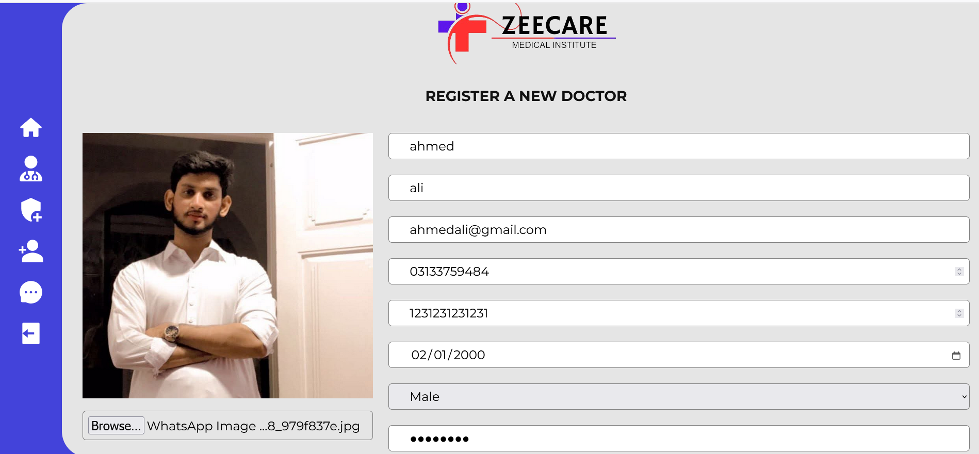

Slide 20
